Slide 1
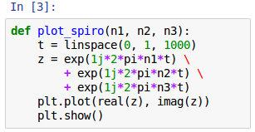
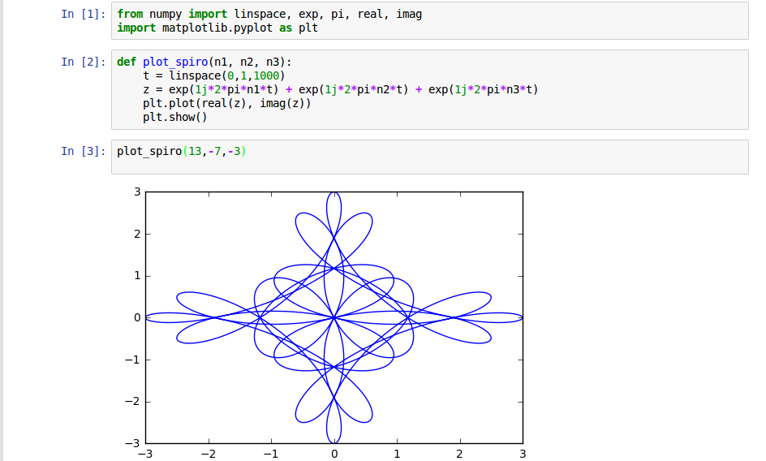
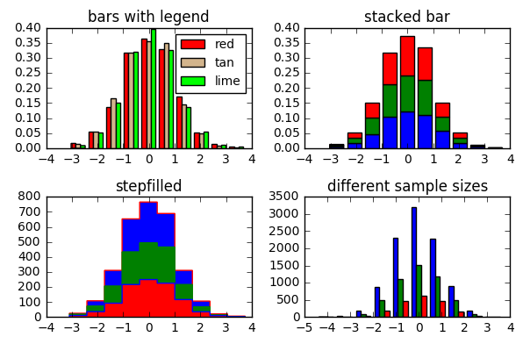
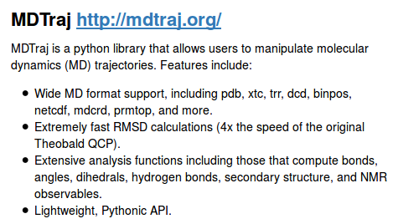
Jupyter Notebooks
Derrick Kearney
HUBzero® Platform for Scientific Collaboration
Purdue University
This work licensed under
Creative Commons
See license online:
by-nc-sa/3.0

Slide 2
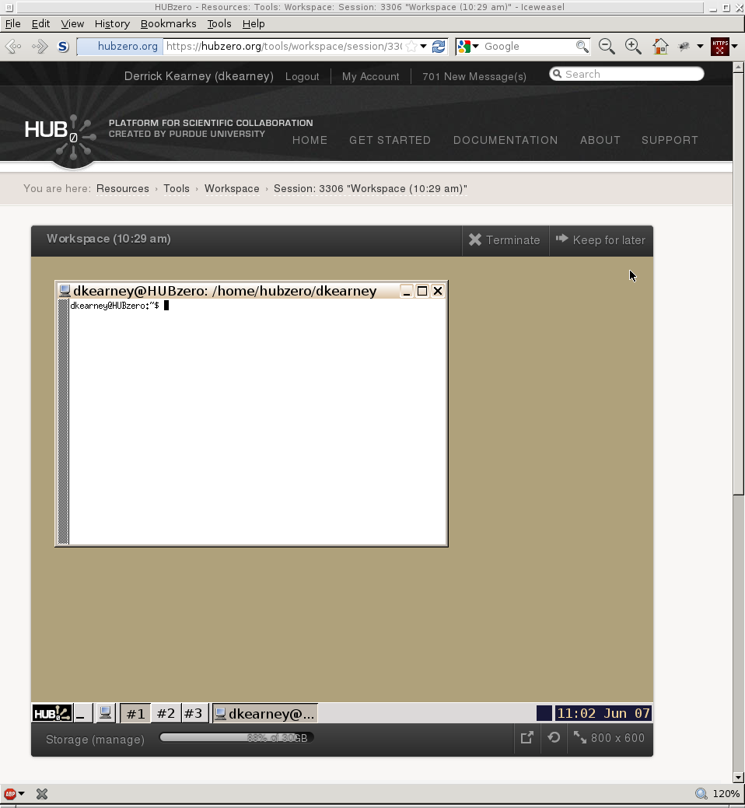
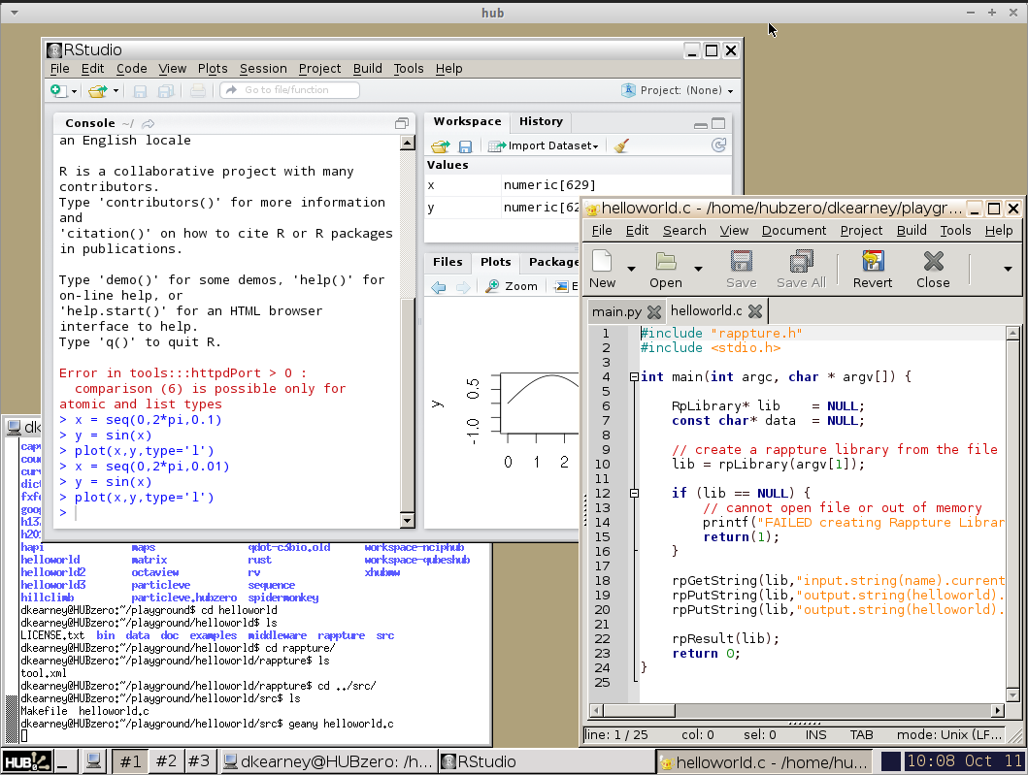

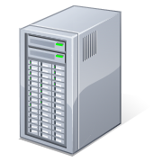
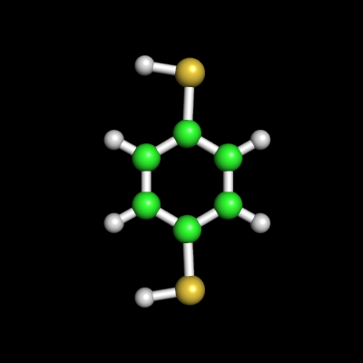
Interactive Desktop Applications
User's Web Browser
HUBzero Infrastructure
Web Server
Middleware
Grid
Submit
Proxy
Tool Session
Containers
Visualization

Slide 3
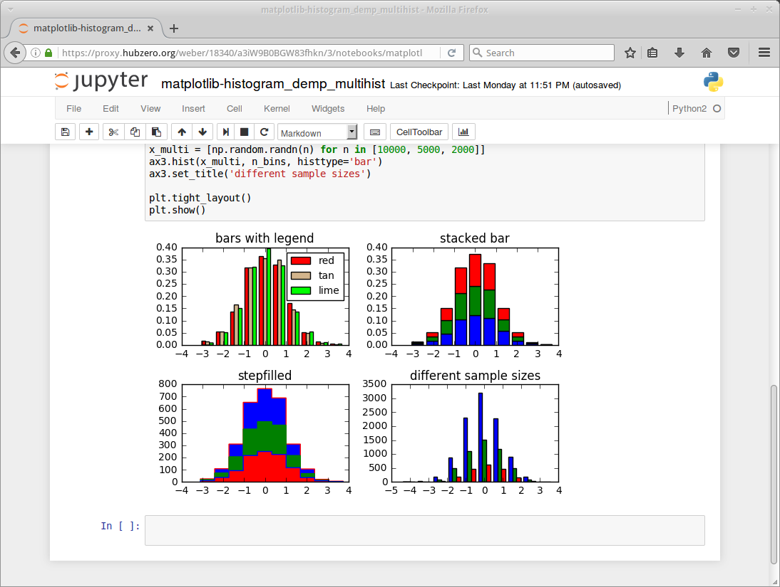
Interactive Jupyter Notebooks
User's Web Browser
HUBzero Infrastructure
Web Server
Middleware
Grid
Submit
Proxy
Tool Session
Containers
Visualization

Slide 4
What are Jupyter Notebooks?
Executable Code
Jupyter Notebook
calculations.ipynb

Slide 5
What are Jupyter Notebooks?
Executable Code
Data Visualizations
Jupyter Notebook
calculations.ipynb

Slide 6
What are Jupyter Notebooks?
Executable Code
Data Visualizations
Jupyter Notebook
calculations.ipynb
Documentation

Slide 7




Sharing Notebooks
Store
Static
Interactive
☑
☑

☑

☑

☑
☑

Jupyter Notebook
calculations.ipynb
☑



Slide 8
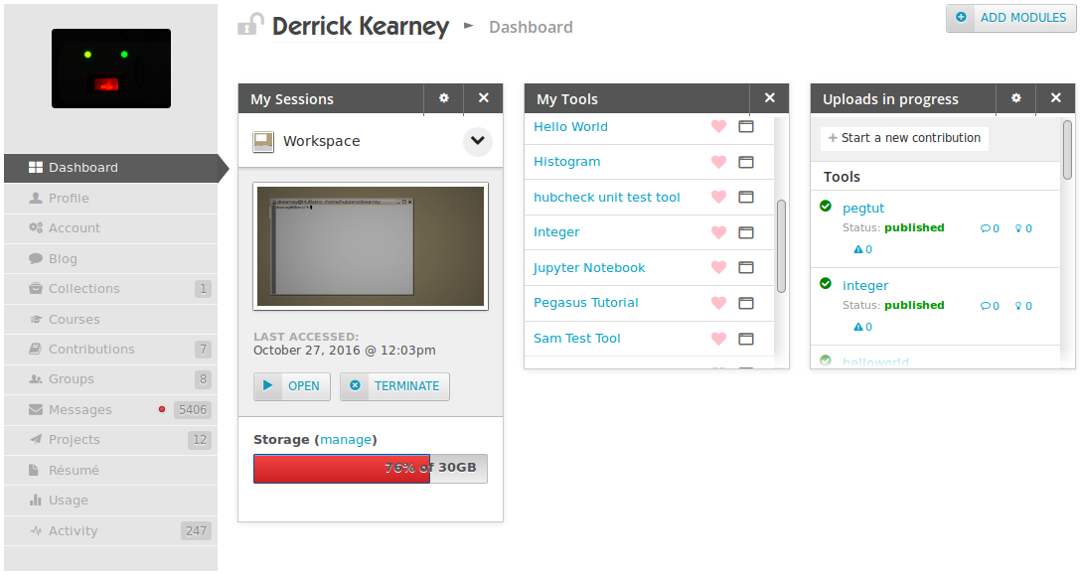
Getting Started: Dashboard

Slide 9
My Tools → Jupyter Notebook

Slide 10
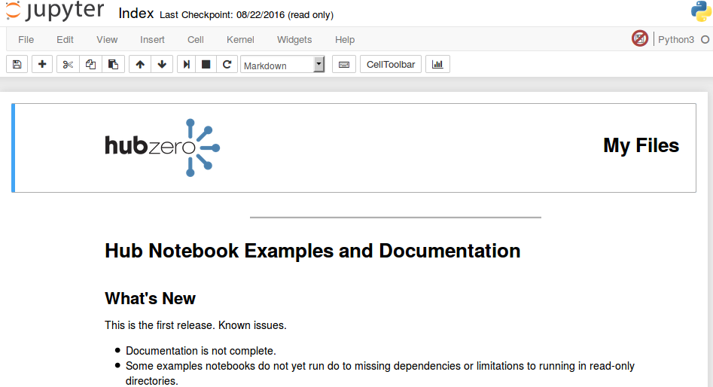
Notebook Intro Page

Slide 11
Find your Notebooks in “My Files”

Slide 12
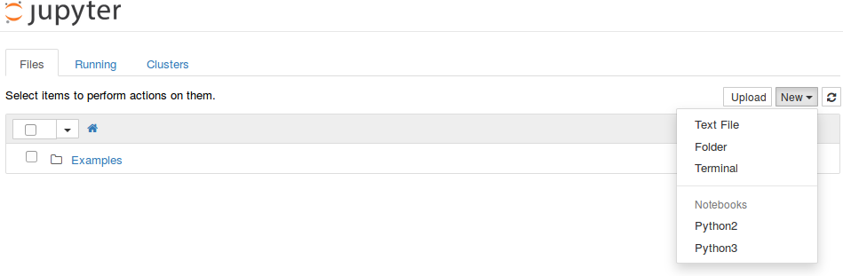
Open a New Python2 Notebook

Slide 13
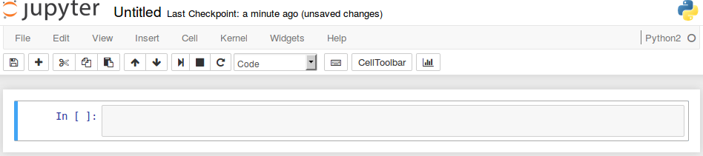
Getting Familiar

Slide 14
Getting Familiar: Header
Header

Slide 15
Getting Familiar: Menu Bar
Menu Bar

Slide 16
Getting Familiar: Notebook Area
Notebook Area

Slide 17
Write programs in Code cells

Slide 18
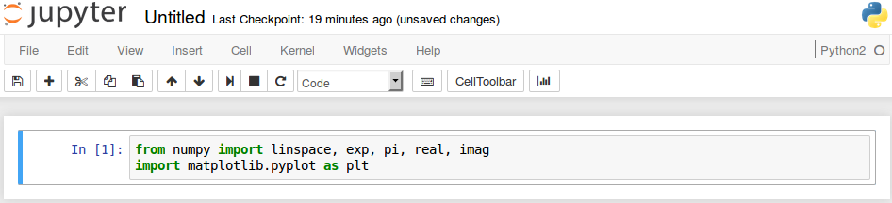
Execute a cell with Shift+Enter

Slide 19
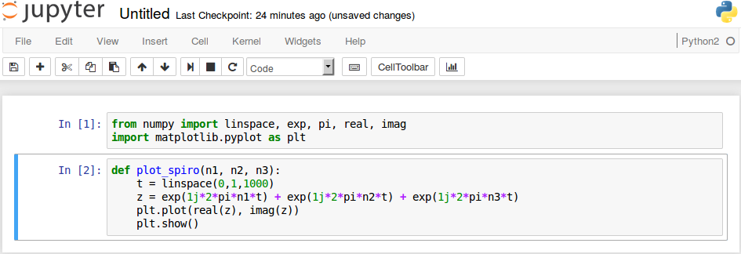
Store functions in Code cells

Slide 20
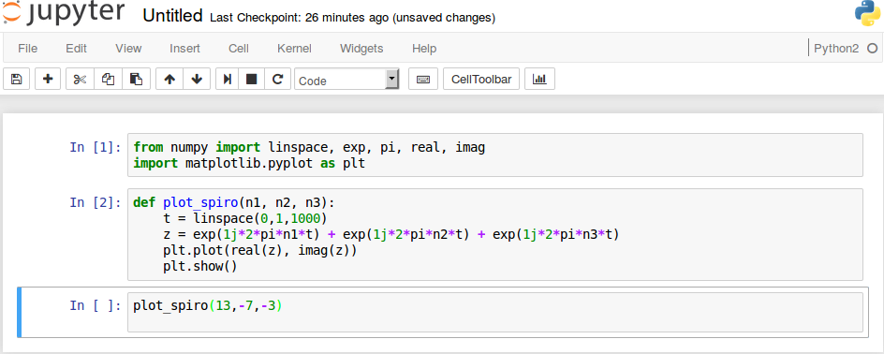
Call functions

Slide 21
Visualize your data

Slide 22
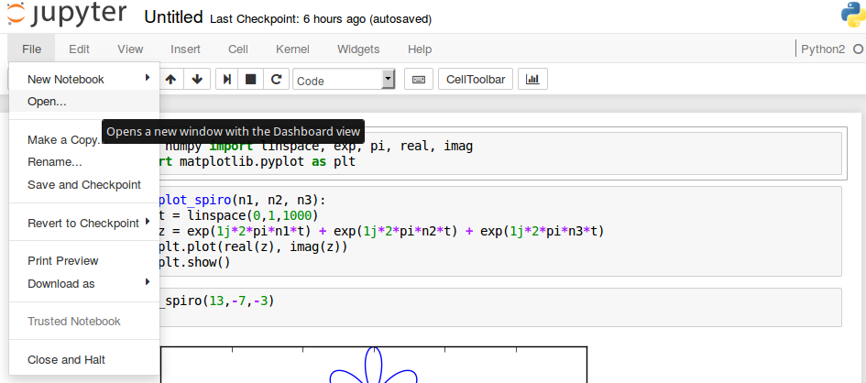
Open New Files and Terminals

Slide 23
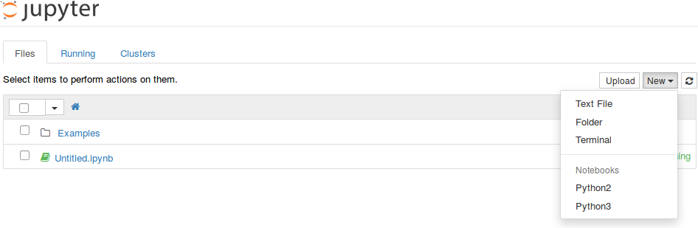
Open New Files and Terminals

